Slide 1

Fantasy Football Lineup Optimizer
Hugh Goode, Matt Brillantes

Slide 2
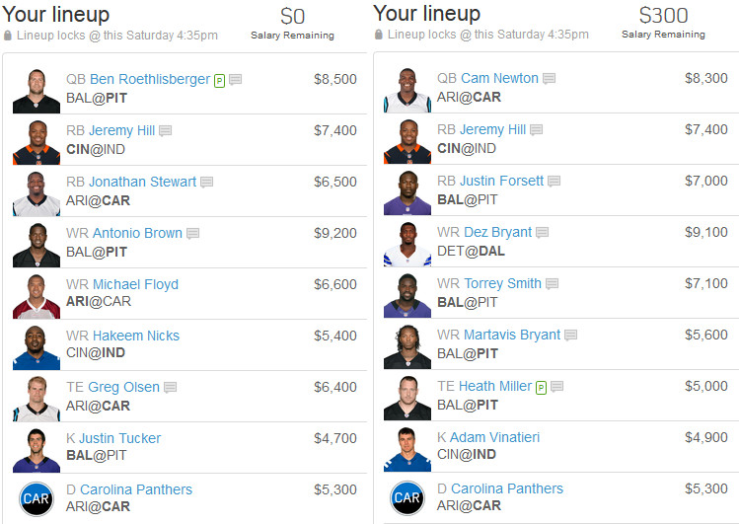
Intro/Recap

Slide 3
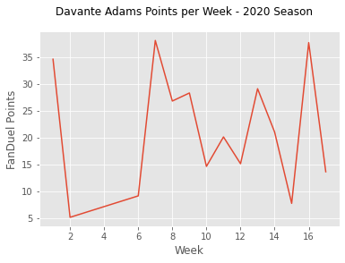
Project 1 Overview
Name | Pos | FanDuel Salary | Cumulative Points | Games Played | Average Points (Projection for Future Performance) | Cost per Point | Value Rank
Brown, Marquise | WR | $6,800 | 89.6 | 5 | 17.92 | $379.46 | 1
Williams, Mike | WR | $7,700 | 100.6 | 5 | 20.12 | $382.70 | 2
Samuel, Deebo | WR | $7,700 | 94.5 | 5 | 18.9 | $407.41 | 3
Kupp, Cooper | WR | $8,400 | 100.3 | 5 | 20.06 | $418.74 | 4
Chase, Ja'Marr | WR | $7,300 | 86.9 | 5 | 17.38 | $420.02 | 5
Brown, Antonio | WR | $6,500 | 61.1 | 4 | 15.275 | $425.53 | 6
Hill, Tyreek | WR | $8,500 | 96.6 | 5 | 19.32 | $439.96 | 7
Evans, Mike | WR | $7,000 | 77.8 | 5 | 15.56 | $449.87 | 8
Adams, Davante | WR | $8,200 | 90.9 | 5 | 18.18 | $451.05 | 9
Metcalf, D.K. | WR | $7,400 | 80.8 | 5 | 16.16 | $457.92 | 10

Slide 4
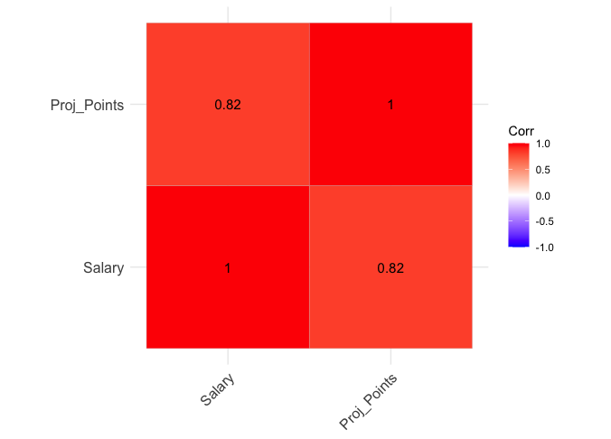
New Data – DraftKings Projections & Salaries for upcoming contests
Note: Correlation between salary and actual points = 0.58

Slide 5
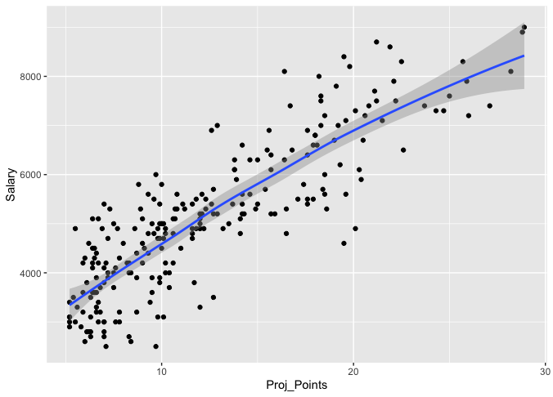
Linear Equation : y = 3.9x - 10.6
R^2 = 0.67
Residual Standard Error = 3.6

Slide 6
Possible Lineup Combinations
C = n! / ((n-r)! * r!)
C = combination
n = number of items
r = items to select
QB: n = 32, r = 1
RB: n = 64, r = 2
WR: n = 96, r = 3
TE: n = 32, r = 1
K: n = 32, r = 1
DEF: n = 32, r =1
32 * 2,016 * 142,880 * 32 * 32 * 32 = 302 Trillion Lineup

Slide 7
Random Walk
Create script to randomly generate lineups fitting the position and salary requirements
Inputs:
Table of players with positions, salaries, and project points
Number of lineups to simulate
Sort lineups by total projected team points
Output:
Top n lineups

Slide 8
Knapsack Problem
Given a set of items, each with a weight and a value, determine the number of each item to include in a collection so that the total weight is less than or equal to a given limit and the total value is as large as possible.
Linear programming is a technique for the optimization of linear objective function, subject to linear equality and linear inequality constraints
R Library “lpSolve”

Slide 9
App Demo

Slide 10
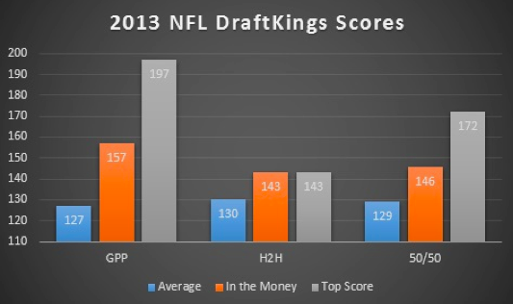
Compare Results
Average points in contest: 127
Average in the money score: 157
Average top score: 197
Source: rotogrinders.com

Slide 11
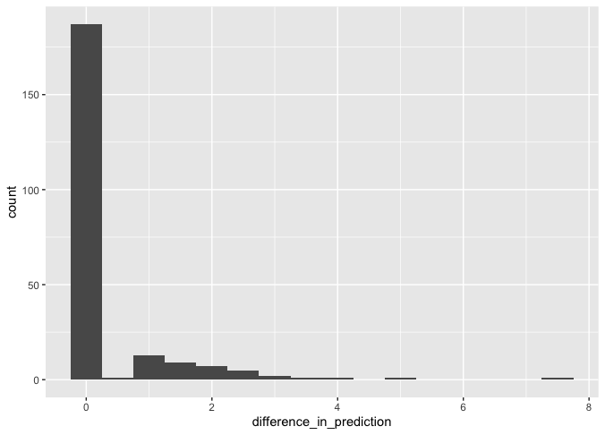
Histogram of Difference in Projection (Filter out players with projected points < 5)

Slide 12
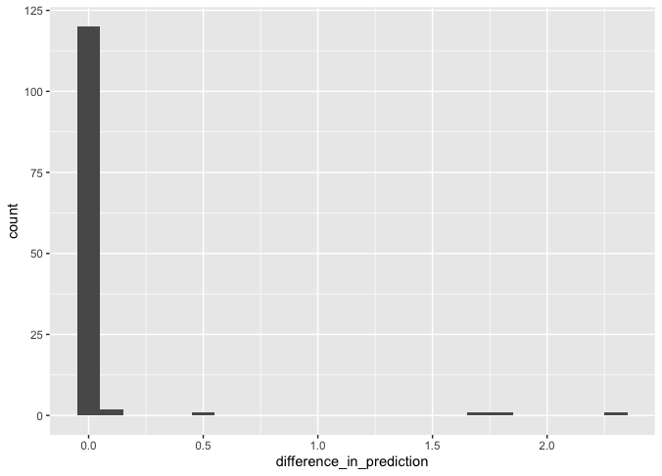
Histogram of Difference in Projection (Filter out players with projected points < 10)

Slide 13
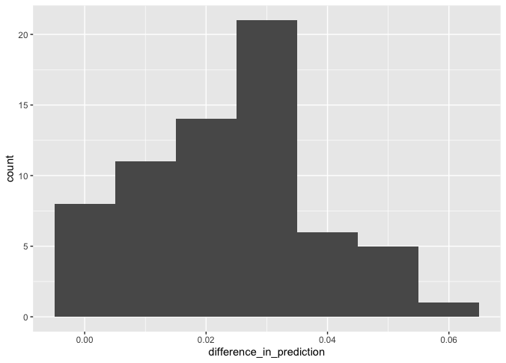
Histogram of Difference in Projection (Filter out players with projected points <15)

Slide 14
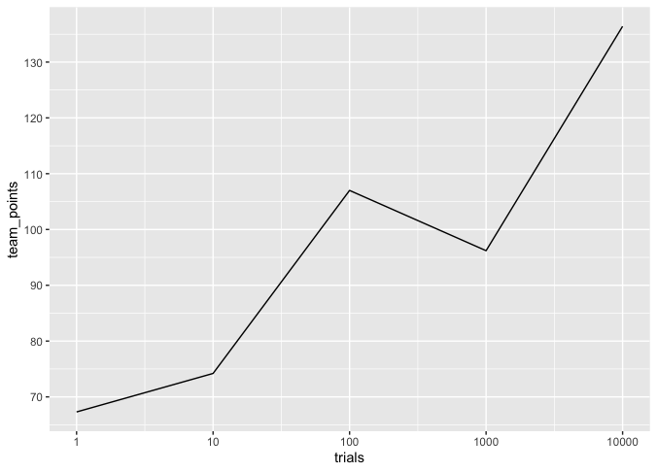
Improvement in Random Walk as #trials increase
LP Solver solution: 174

Slide 15
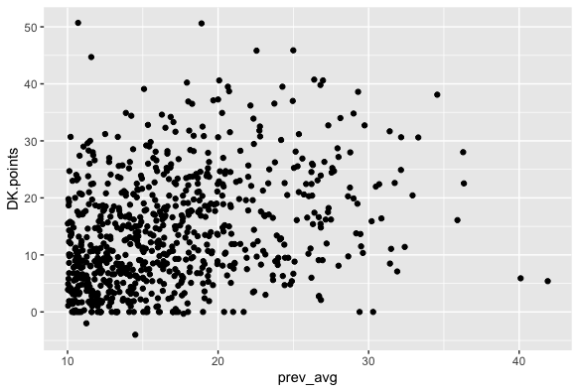
Prev. Week Projection vs. Actual Points

Slide 16
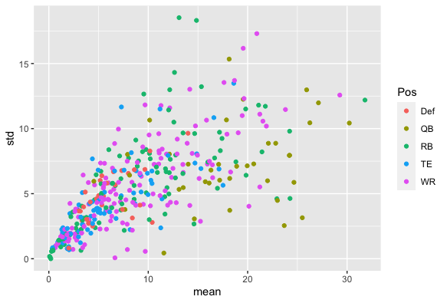
Average Points for Player vs. Standard Deviation

Slide 17
Conclusions & Next Steps
Include player standard deviation as constraint in LP Solver function
Incorporate actual player game statistics and create model to run more accurate predictions than running average
Add NBA tab to app, other sports?

